Slide 1

Geometry
Unit 1, Lesson 6 Transformations on the Plane – Part 2 Volume 1, pg. 34

Slide 2


Benchmark
MA.912.GR.2.3
Identify a sequence of transformations that will map a given figure onto itself or onto another congruent or similar figure.
volume 1, pg. 34

Slide 3
Integrated Mathematical Thinking and Reasoning Standards
MA.K12.MTR.1.1 Actively participate in effortful learning both individually and collectively.
MA.K12.MTR.2.1 Demonstrate understanding by representing problems in multiple ways.
MA.K12.MTR.4.1 Engage in discussions that reflect on the mathematical thinking of self and others.
MA.K12.MTR.5.1 Use patterns and structure to help understand and connect mathematical concepts.
volume 1, pg. 34

Slide 4

Learning Target
I can describe a single transformation that was applied
volume 1, pg. 34

Slide 5

Warm-Up
volume 1, pg. 34

Slide 6
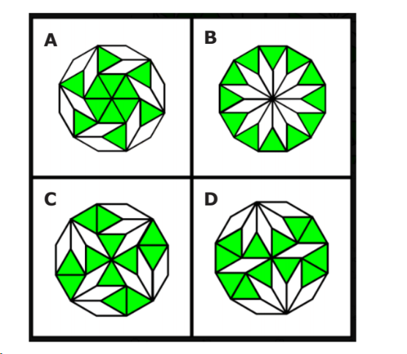
1.6.1 Warm-Up: Which One Doesn’t Belong?
The diagram shows four polygons.
Which polygon does not belong?
Describe your reasoning.
volume 1, pg. 34

Slide 7

Guided Instruction
volume 1, pg. 35

Slide 8
1.6.2 Guided Instruction: Determining a Single Transformation
The diagram shows $VWXY$ and $V′W′X′Y′$. $V′W′X′Y′$ is a transformation of $VWXY$.
volume 1, pg. 35

Slide 9
Describe the single transformation that was used to create $V′W′X′Y′$.
Type of Transformation | Center, Line, or Movement | Degrees or Scale Factor
Dilation Rotation Reflection Translation | Center of dilation is _____. Center of rotation is _____. Line of reflection is ______. Down Left Right Up
volume 1, pg. 35

Slide 10
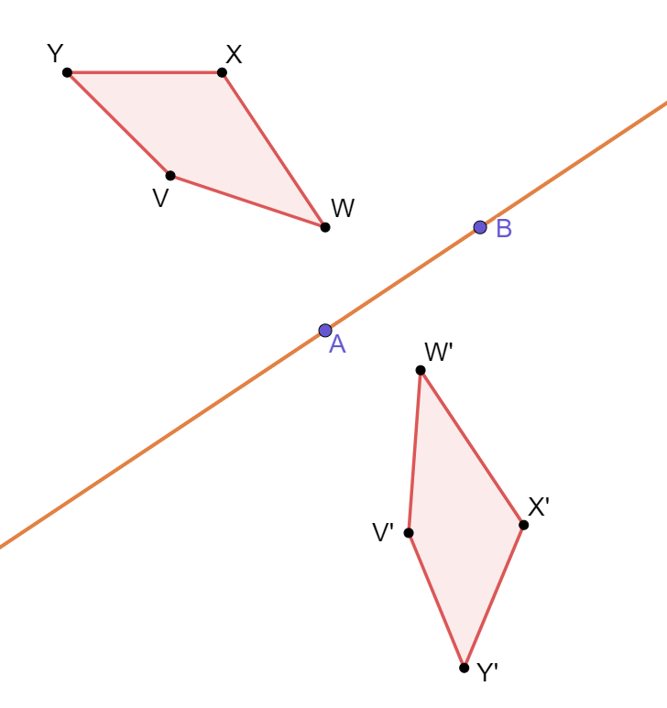
The diagram shows $VWXY$ and $V′W′X′Y′$. $V′W′X′Y′$ is a transformation of $VWXY$.
volume 1, pg. 35

Slide 11
Describe the single transformation that was used to create $V′W′X′Y′$.
Type of Transformation | Center, Line, or Movement | Degrees or Scale Factor
Dilation Rotation Reflection Translation | Center of dilation is _____. Center of rotation is _____. Line of reflection is ______. Down Left Right Up
volume 1, pg. 35

Slide 12
The diagram shows $VWXY$ and $V′W′X′Y′$. $V′W′X′Y′$ is a transformation of $VWXY$.
volume 1, pg. 36

Slide 13
Describe the single transformation that was used to create $V′W′X′Y′$.
Type of Transformation | Center, Line, or Movement | Degrees or Scale Factor
Dilation Rotation Reflection Translation | Center of dilation is _____. Center of rotation is _____. Line of reflection is ______. Down Left Right Up
volume 1, pg. 36

Slide 14
The diagram shows $VWXY$ and $V′W′X′Y′$. $V′W′X′Y′$ is a transformation of $VWXY$.
volume 1, pg. 36

Slide 15
Describe the single transformation that was used to create $V′W′X′Y′$.
Type of Transformation | Center, Line, or Movement | Degrees or Scale Factor
Dilation Rotation Reflection Translation | Center of dilation is _____. Center of rotation is _____. Line of reflection is ______. Down Left Right Up
volume 1, pg. 36

Slide 16
Complete the chart so it can be used to distinguish between similar-looking transformations. First, write your own hints. Then, exchange hints with your partner.
Transformation | My Hints | My Partner’s Hints
Dilation
Reflection
Rotation
Translation
volume 1, pg. 37

Slide 17
Which transformations resulted in congruent figures?
Dilation
Reflection
Rotation
Translation
When a transformation results in a congruent figure, what is another name that can be used for that transformation?
volume 1, pg. 37

Slide 18

Guided Practice
volume 1, pg. 37

Slide 19

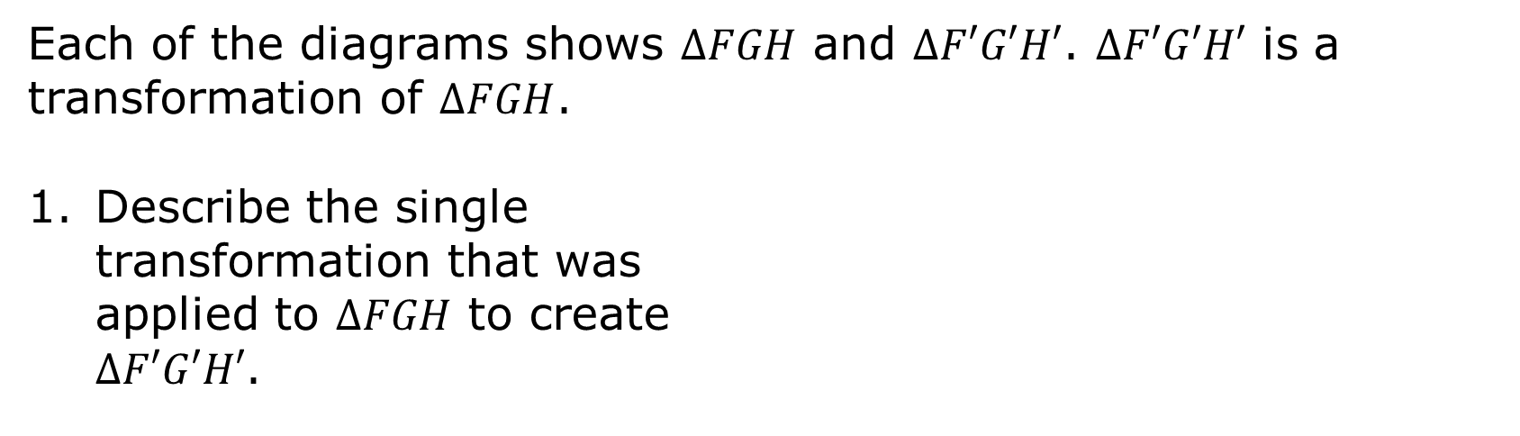
1.6.3 Guided Practice: Describing Transformations
Each of the diagrams shows $∆FGH$ and $∆F′G′H′$. $∆F′G′H′$ is a transformation of $∆FGH$.
Describe the single
transformation that was
applied to $∆FGH$ to create
$∆F′G′H′$.
volume 1, pg. 37

Slide 20
Describe the single transformation that was applied to $∆FGH$ to create $∆F′G′H′$.
volume 1, pg. 38

Slide 21

Describe the single transformation that was applied to $∆FGH$ to create $∆F′G′H′$.
Review your hints chart and add anything else you think will be helpful.
volume 1, pg. 38

Slide 22

Your Turn
volume 1, pg. 39

Slide 23
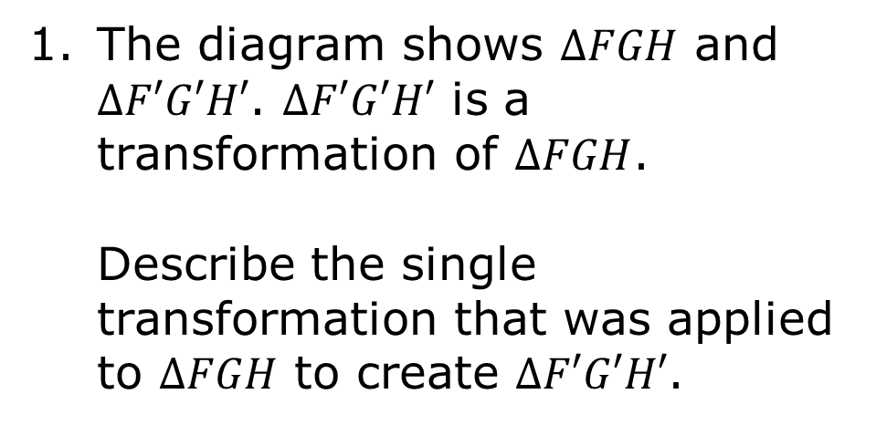
1.6.4 Your Turn!
The diagram shows $∆FGH$ and $∆F′G′H′$. $∆F′G′H′$ is a transformation of $∆FGH$.
Describe the single transformation that was applied to $∆FGH$ to create $∆F′G′H′$.
volume 1, pg. 39

Slide 24

The diagram shows $∆FGH$ and $∆F′G′H′$. $∆F′G′H′$ is a transformation of $∆FGH$.
Describe the single transformation that was applied to $∆FGH$ to create $∆F′G′H′$.
volume 1, pg. 39

Slide 25

Wrap-Up
volume 1, pg. 40

Slide 26
1.6.5 Wrap-Up: Ticket Out the Door
The diagram shows four different single transformations of $∆YFB$.
volume 1, pg. 40

Slide 27
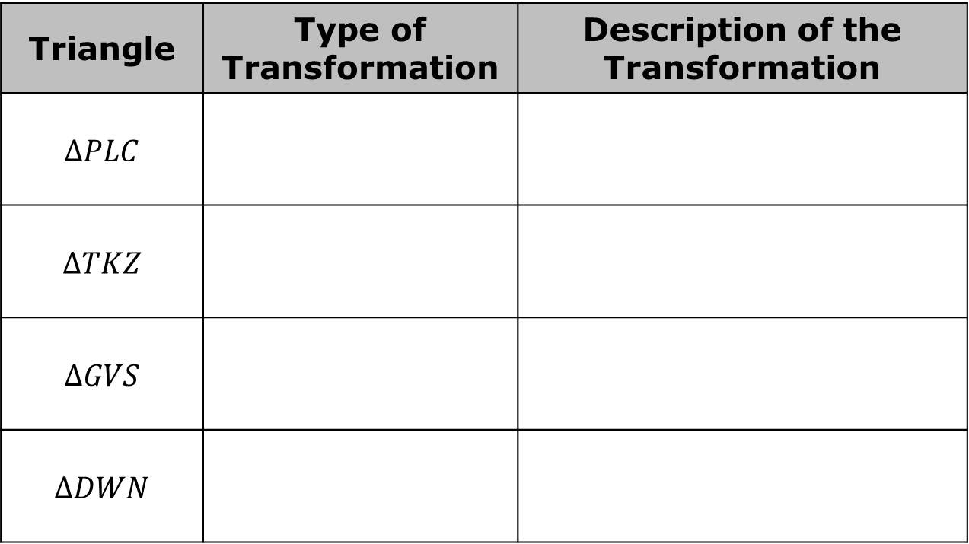

Complete the chart by naming and describing the type of transformation that was applied to $∆YFB$ to result in each triangle.
Triangle | Type of Transformation | Description of the Transformation
$$∆PLC$$
$$∆TKZ$$
$$∆GVS$$
$$∆DWN$$
volume 1, pg. 40

